Slide 1
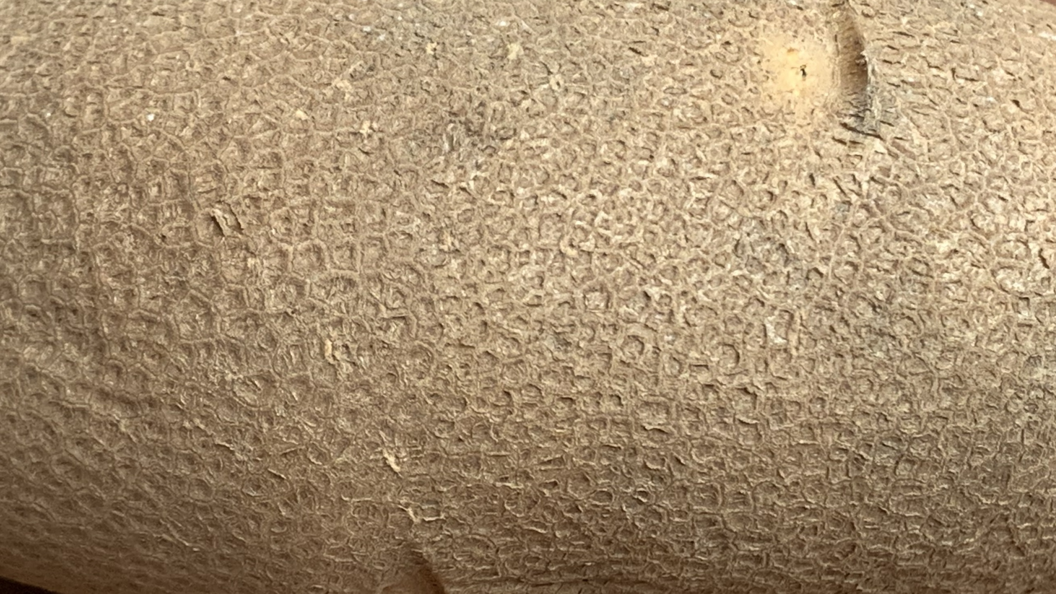
Potato skin: the best defense against storage loss
Paul Bethke
USDA and University of Wisconsin
2024 Winter Potato Conference
Jan 31- Feb 1, 2024
East Lansing, MI

Slide 2
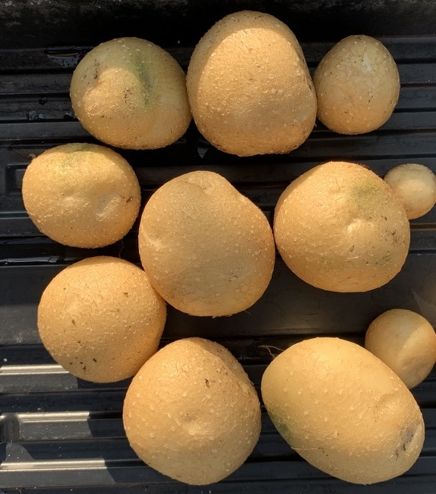
Our roadmap
Storage losses
Description of potato skin
Skinning and skinning resistance
Water retention
Wound healing and disease susceptibility

Slide 3
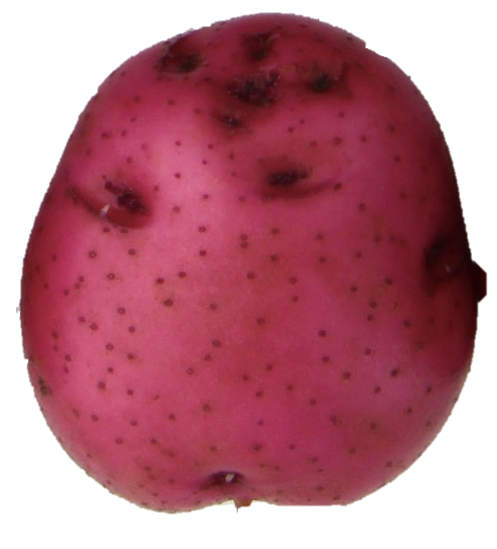
Guiding principles
Nothing contributes more to successful potato storage than healthy potatoes
Protecting the skin from injury is one of the most effective ways to keep potatoes healthy

Slide 4
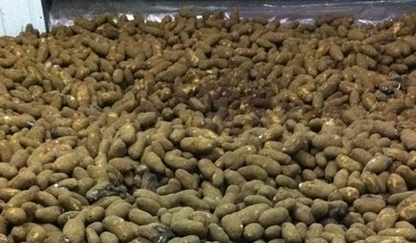
An undamaged skin minimizes storage losses
Shrink: Water loss
Shrink: Disease
Poor appearance

Slide 5
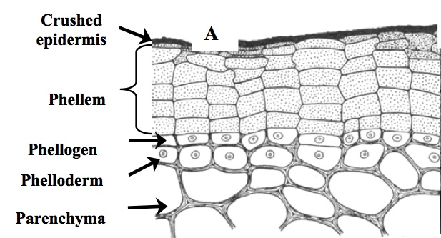
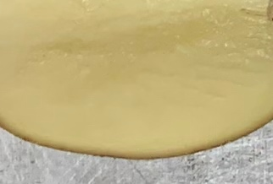
A detailed look at the potato skin
British Potato Council Project Report 2006/1
Notes:
1/64 inch or less
6-12 cells thick

Slide 6
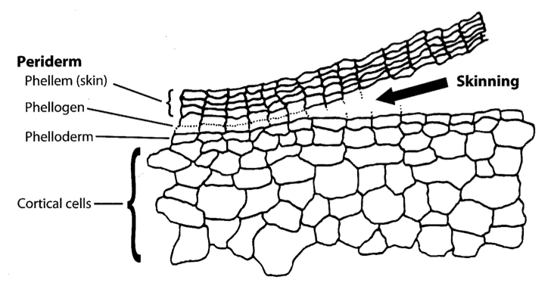
Skinning occurs when the weak cells of the phellogen are torn by shearing forces
Bussan, Sabba and Drilias 2009
Adapted from E. C. Lulai, 2002
Notes:
When do we have shearing forces?

Slide 7
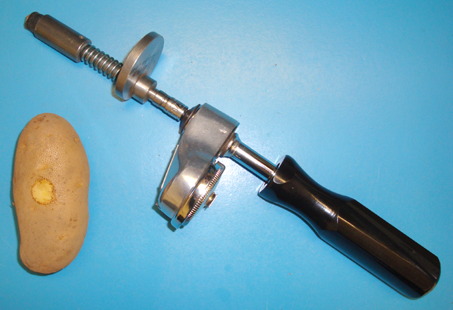
Skin set can be measured

Slide 8
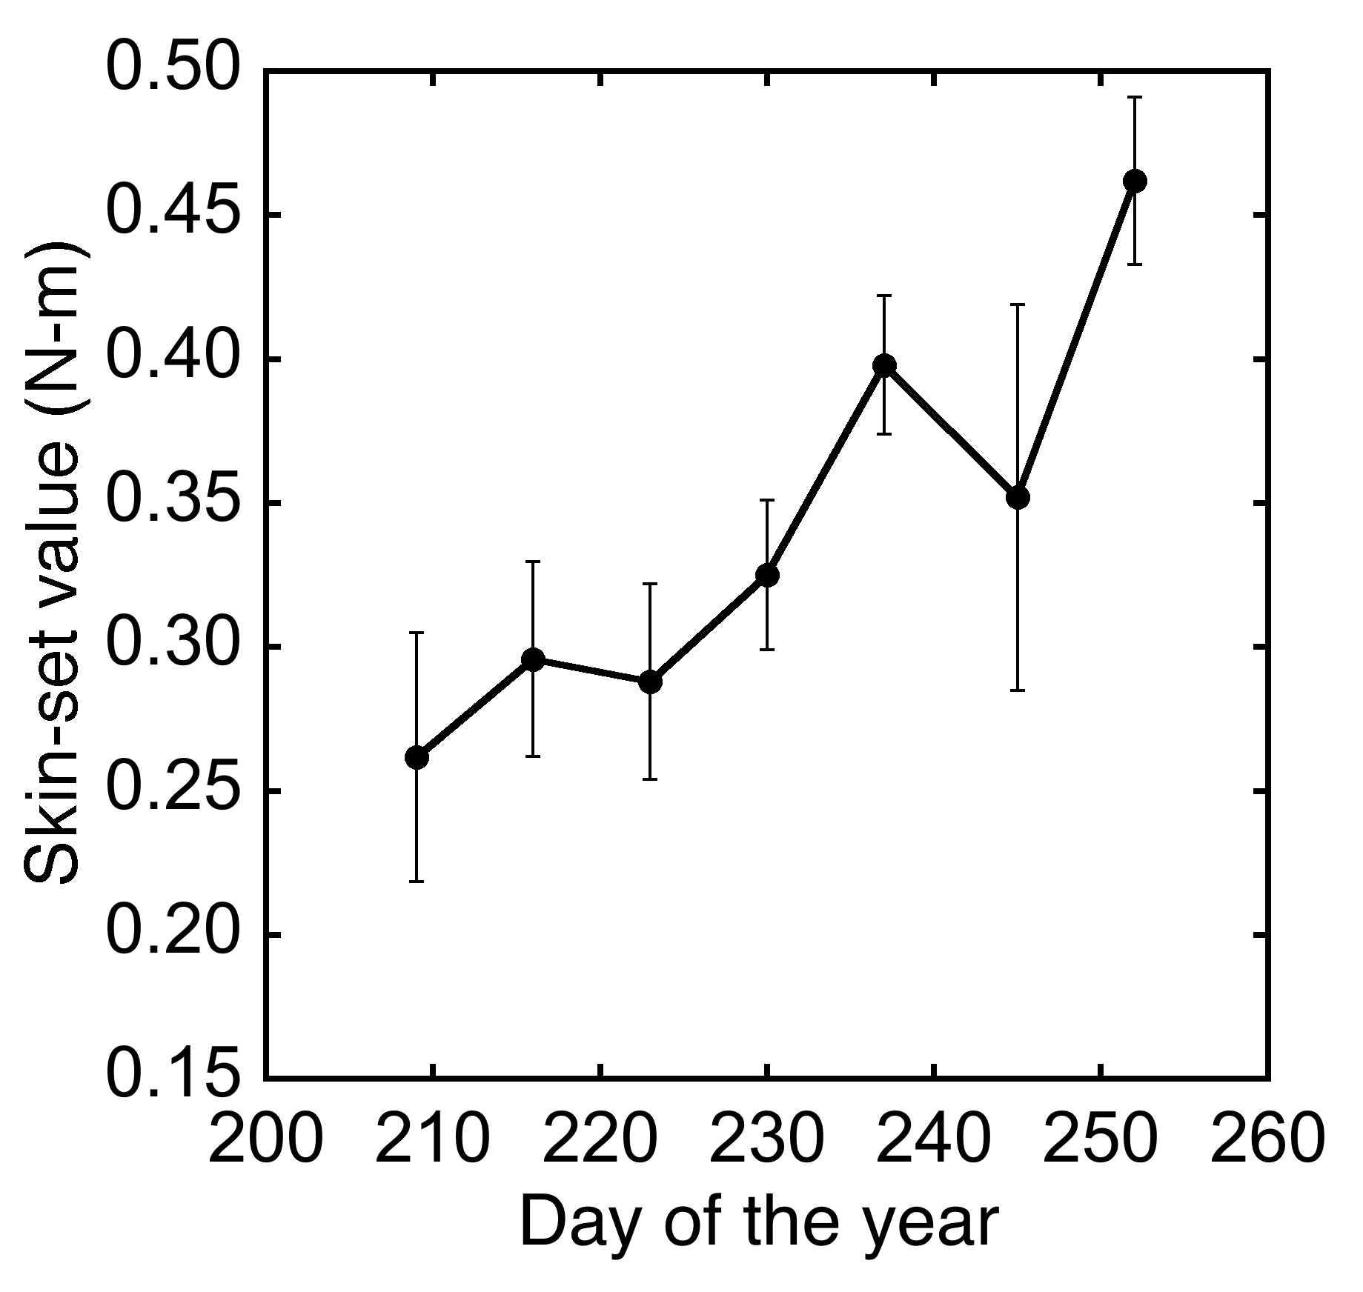
Resistance to skinning increases throughout the growing season
Snowden
Sept 9
July 21

Slide 9
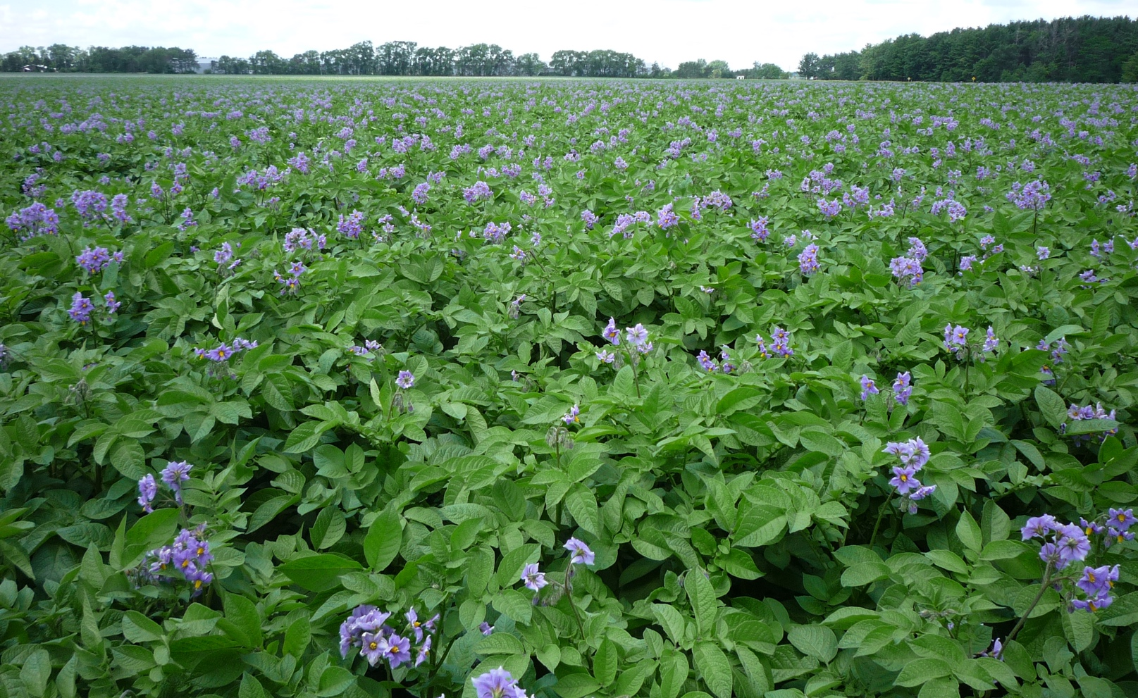
Potatoes must stop growing before they can set a durable skin
Skin set takes time
2-3 weeks is usually enough time when vines are approaching maturity
More time may be needed when potatoes are growing faster

Slide 10
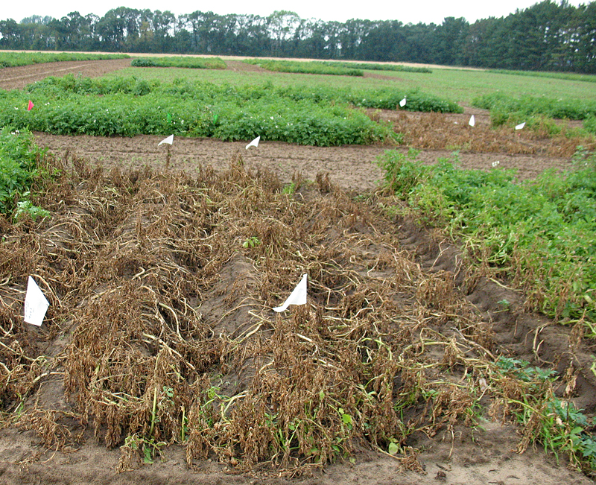
Does vine kill accelerate skin set?
Notes:
Syngenta diquot
Tubers were harvested from green vines and vines treated with herbicide

Slide 11
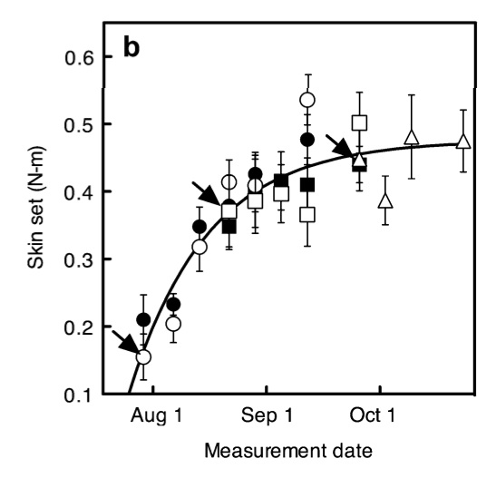
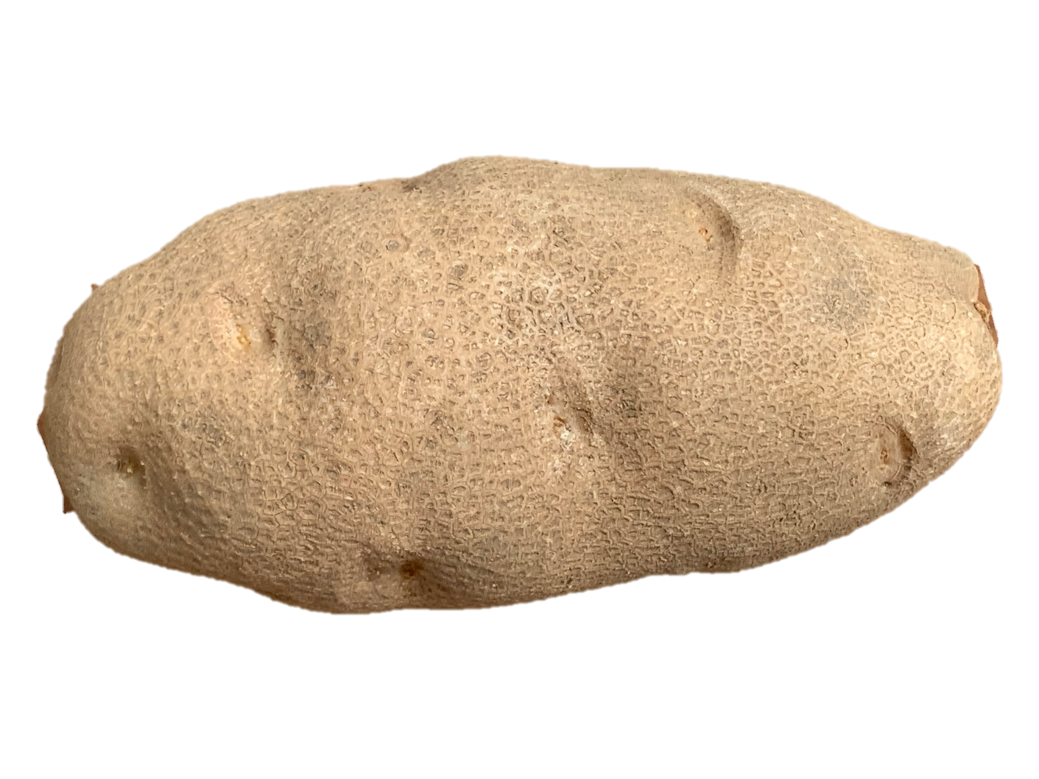
Vine kill treatment had a small effect on the rate of skin set
Russet Burbank
Bethke, Paul C., and James S. Busse. 2010. Vine-Kill Treatment and Harvest Date have Persistent Effects on Tuber Physiology. American Journal of Potato Research 87: 299–309.
Notes:
Torque required for skinning of the periderm for Russet Burbank tuber samples from 2007 (a) and 2008 (b) measured on different days of the calendar year. Arrows indicate data points for tubers 1 day after harvest without a vine-kill treatment. Tubers were harvested at early (circles), middle (squares) or late season (triangles) from plants treated with vine desiccant (filled symbols) or untreated (unfilled symbols).
Time to stop tubers from growing depends on date of vine kill. Earlier is less effective.
Reglone® (active ingredient diquat dibromide, Syngenta Crop Protection, Greensboro, NC), was used for vine-kill treatments. Product was applied as a foliar spray twice, 2 weeks and 1 week prior to harvest, at a rate of 1.43 L/ha after diluting 1:2000 with water. On the day of harvest, vines were cut above the soil line with hand shears and tubers laid up with a tractor mounted single row lifter. Tubers without evidence of disease or damage and with <2% of the tuber surface “skinned”, typically 0%, were collected in crates and preconditioned for three to 6 weeks in a storage locker at 12.7°C and 90–95% relative humidity. Tubers were harvested on July 24, August 21 and Sept 18, 2007 and on July 28, August 20 and September 24, 2008 with the last harvest in both years being 1–2 weeks after complete natural senescence of stems had occurred.

Slide 12
Water loss in storage
Harvest management
Water loss depends on…
Resistance of skin to water movement
Water vapor content of the surrounding atmosphere
Storage management

Slide 13
The skin as a barrier to water loss
The skin is impregnated with waxes
Removal of skin increases water loss by 250-1000 times
Healed skin loses water more readily than the original skin
Water loss contributes to blackspot and pressure bruise
Normal
Reduced wax
Serra et al. 2010. The Plant Journal 62: 277–290
Notes:
Recovery out of storage. Like recovery at the chip plant.
A rapid decrease in water vapor conductance was detected during the first 24 h of healing after mature, whole tubers were wounded by tangentially cutting into the cortex. The rapid decline in vapor conductance, indicating deposition of soluble waxes, was not concurrent with detectable deposition of polymeric phenolic or polymeric aliphatic components of the suberin polyester; instead these polymerized components were detected after vapor conductance decreased by approximately 80% and was nearly stable. The vapor conductance of wound healing tubers declined in a log-linear fashion during the first 1 to 3 days after wounding depending upon tuber maturity and genotype. Lulai

Slide 14
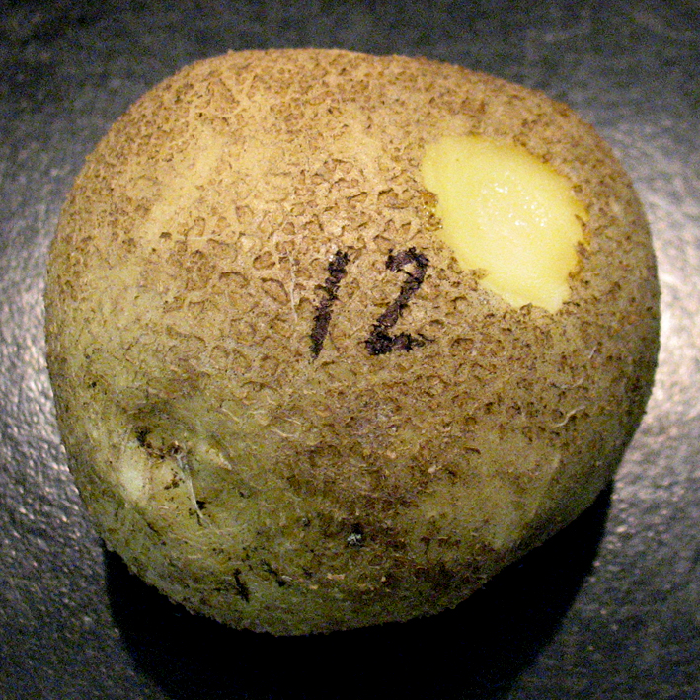
Skinning and water loss
This amount of skinning increased water loss over 3 days by 45%.

Slide 15
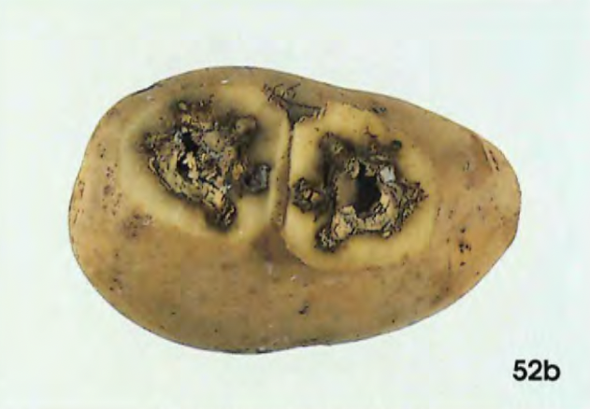
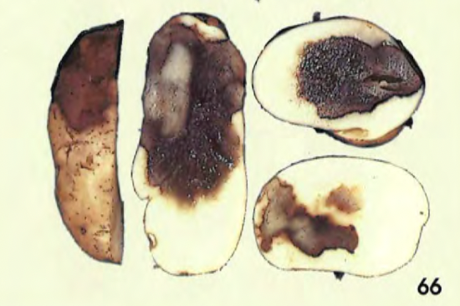
The tuber skin is a barrier to infection
Dry rot (Fusarium species)
Leak (Pythium species)
Pink rot (Phytophthora erythroseptica)
Soft rot (Pectobacterium and Dickeya species)
Notes:
Dry rot is probably the most important cause of postharvest potato losses in the northeastern United States and nationwide. Found in soil. Progeny tubers are not usually infected until harvest because F. sambucinum and F. solani cannot cause infection unless they penetrate the skin and the potato skin is rarely injured during the growing season. Growth cracks, however, can become infected with Fusarium. Damage to tubers at harvest provides a multitude of points of entry for spores that are dormant in soil or on the surface of the tuber. Cornell extension.
Pythium fungus needs wounds to penetrate tuber. Most problematic during warm harvests.
Pink rot. Although initial infection occurs during the early stages of tuber development, the disease becomes most apparent during harvest. Tubers infected with pink ro t in the field will rot during harvest and handling, allowing the pathogen to come into contact with healthy tubers. Wounds and bruises on tubers caused by harvesting and handling provide entry points for the pathogen into healthy tubers, and thus post-harvest rotting is usually more severe than field infection. In moist storage conditions with poor ventilation, the disease spreads rapidly. MSU extension.

Slide 16
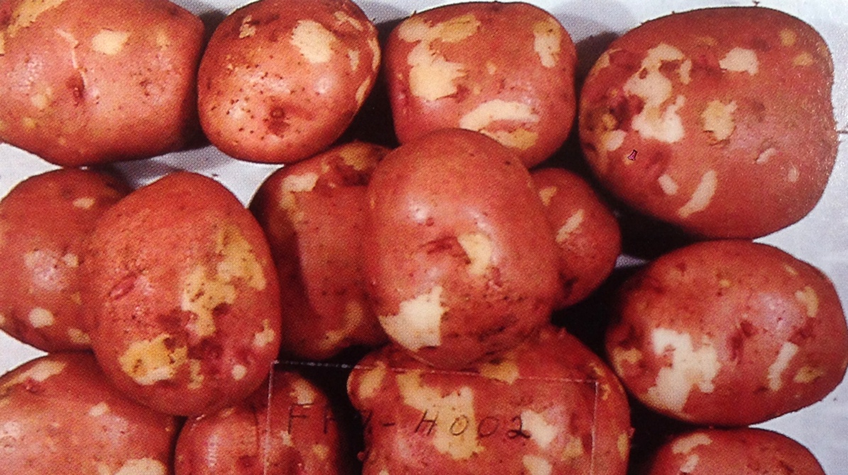
Help your potatoes heal
It is impossible to mechanically harvest potatoes without damage
Healed potatoes protect themselves from disease and minimize water loss
Healing begins with producing a closing layer
A wound periderm forms later and is a more effective, durable protective layer

Slide 17
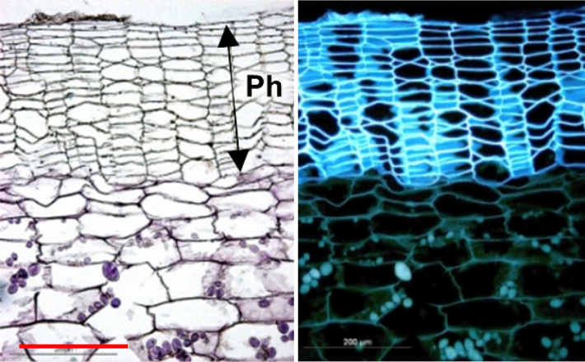
The potato skin viewed with a microscope
Kumar, Pawan, and Idit Ginzberg. 2022. Potato Periderm Development and Tuber Skin Quality. Plants (Basel, Switzerland) 11: 2099. https://doi.org/10.3390/plants11162099.
Notes:
Brick wall of defense

Slide 18
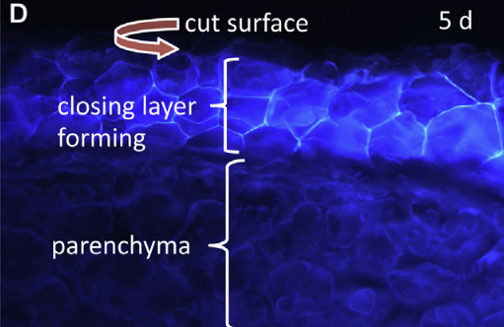
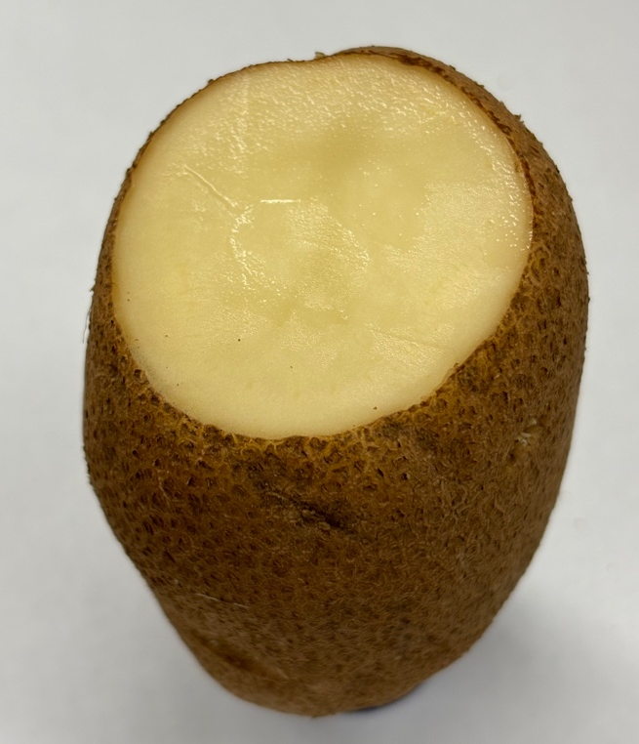
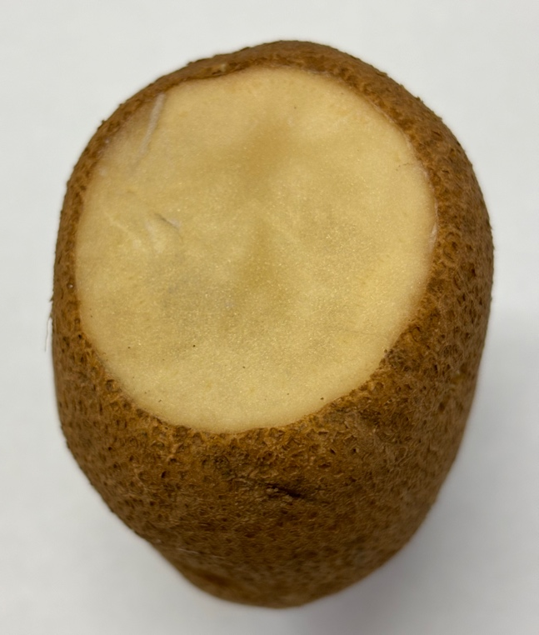
The closing layer is a quick fix for a wounded area
Fresh wound
1 day later
Lulai, Edward C., and Jonathan D. Neubauer. 2014. Wound-induced suberization genes are differentially expressed, spatially and temporally, during closing layer and wound periderm formation. Postharvest Biology and Technology 90: 24–33.
Notes:
Like a scab
High humidity and warm are best for wound healing

Slide 19
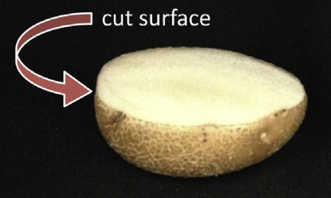
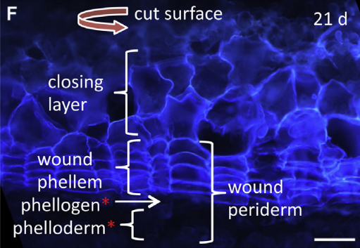
Wound periderm is a durable, highly effective barrier to disease and water loss
Lulai, Edward C., and Jonathan D. Neubauer. 2014. Wound-induced suberization genes are differentially expressed, spatially and temporally, during closing layer and wound periderm formation. Postharvest Biology and Technology 90: 24–33.
Notes:
It takes 2-3 weeks at optimal temperature to produce a fully protective wound periderm

Slide 20
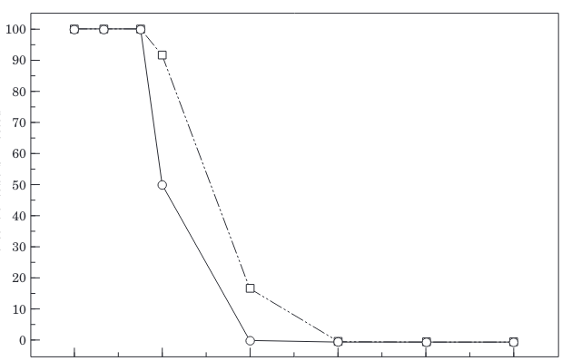
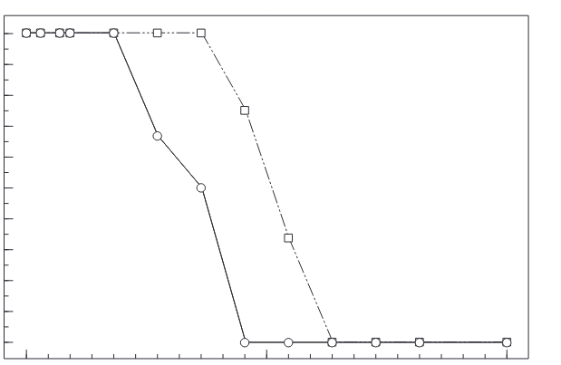
Wound healing for disease resistance takes days
Bacterial soft rot
Fungal dry rot
Percent of tubers infected
0
1
2
3
4
5
0
5
10
Days at 65 ˚F before inoculation
Days at 65 ˚F before inoculation
Lulai, E. C, and D. L Corsini. 1998. Differential deposition of suberin phenolic and aliphatic domains and their roles in resistance to infection during potato tuber (Solanum tuberosum L.) wound-healing. Physiological and Molecular Plant Pathology 53: 209–222.
Notes:
Data for two varieties BelRus and Superior
Pectobacterium and F. Sambucinum
2-3 times longer at 50-55 F

Slide 21
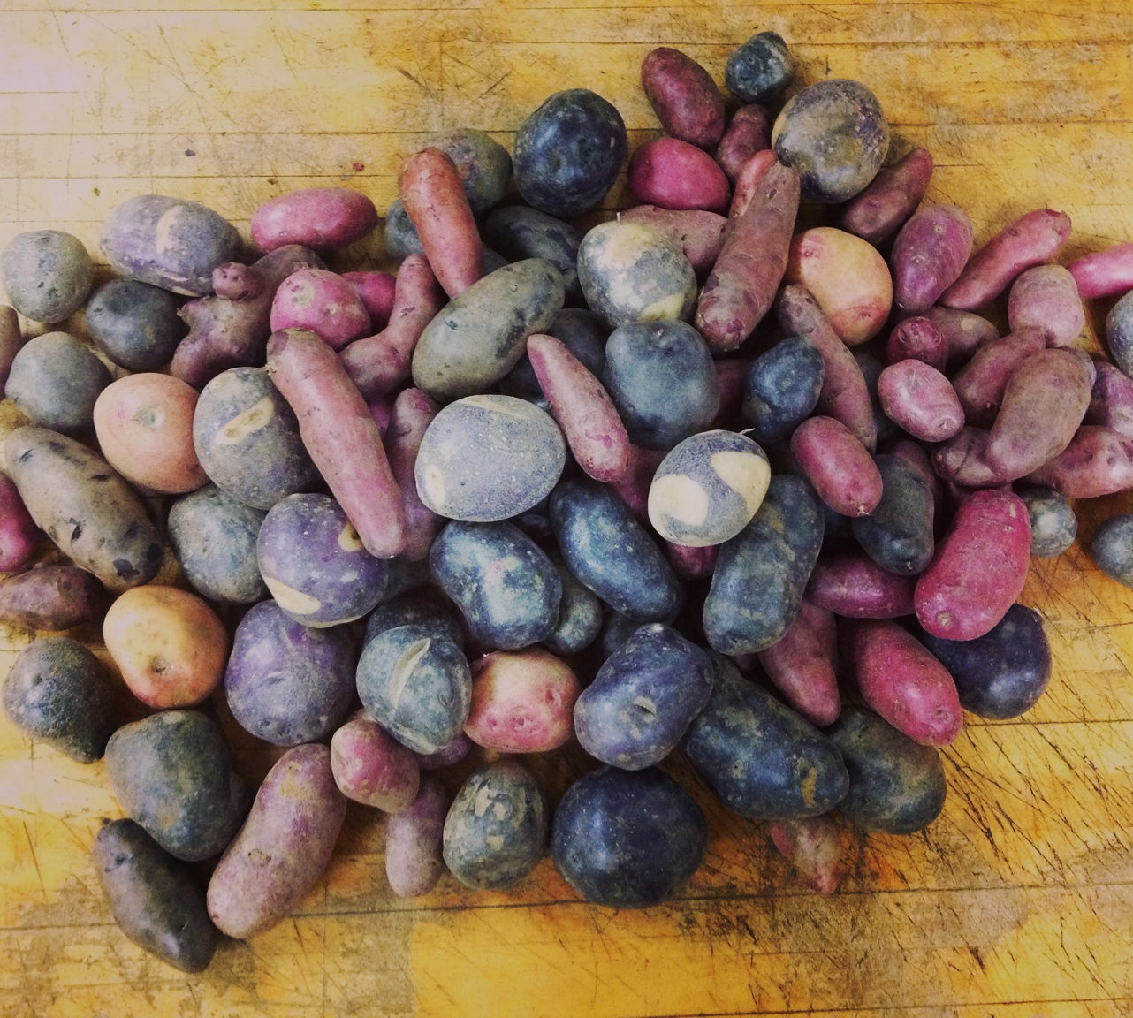
Skin quality
Skin appearance is important in some markets

Slide 22
Pigments accumulate in the skin as potatoes grow

Slide 23
Healed wounds contain almost no red or purple pigments

Slide 24
Reduce seed piece decay by healing cut seed
Wound healing decreases losses from disease
Wounds from sharp knives heal faster than from dull knives
Optimal temperature ~65˚F with high relative humidity
Longer at less than 65˚F is likely to be better
The closing layer is easily damaged

Slide 25
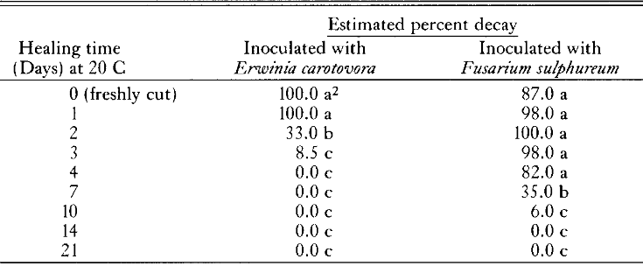
Cut seed develops disease resistance slowly
Healing time (days) at 68˚F*
Nolte, Phillip, Gary A. Secor, and Neil C. Gudmestad. 1987. Wound healing, decay and chemical treatment of cut potato tuber tissue. American Potato Journal 64: 1–9.
*Healing time will be approximately 2-3 as long at 50˚F

Slide 26
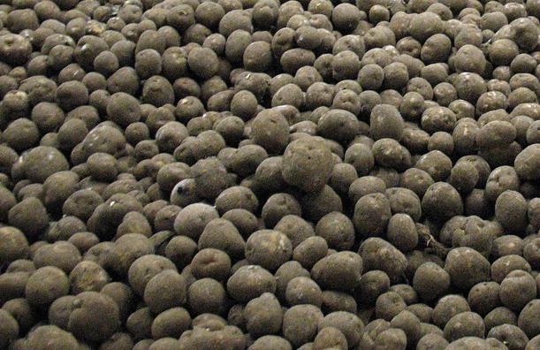
Thank you!

